Slide 1
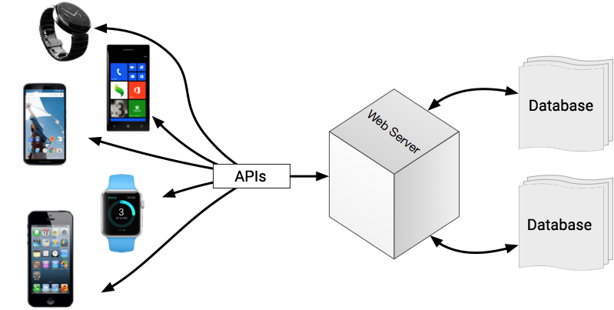
APPLICATION PROGRAMMING INTERFACE-API
-Ibtisam Mogul
Notes:
https://devblogs.microsoft.com/vbteam/introduction-to-live-unit-testing-in-visual-basic/

Slide 2
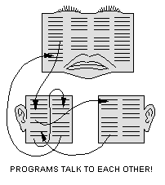
API
Contents
API
Different Types Of Api
(system, Applications, Web)
API evaluation criteria

Slide 3
Application Programming Interface API
API can be defined as a set of rules that determine how one software communicates with another.
API is a set of
commands,
functions and
protocols
which programmers can use when building a software.
It allows the programmers to use
Predefined (built-in) functions to
interact with systems,
instead of writing them from scratch.
Notes:
http://www.stepin-solutions.com/blog/api-programming-backbone-of-mobile-app-development/

Slide 4
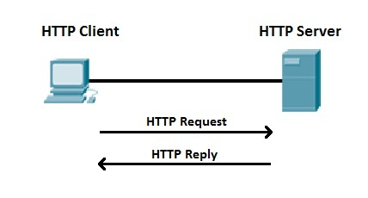
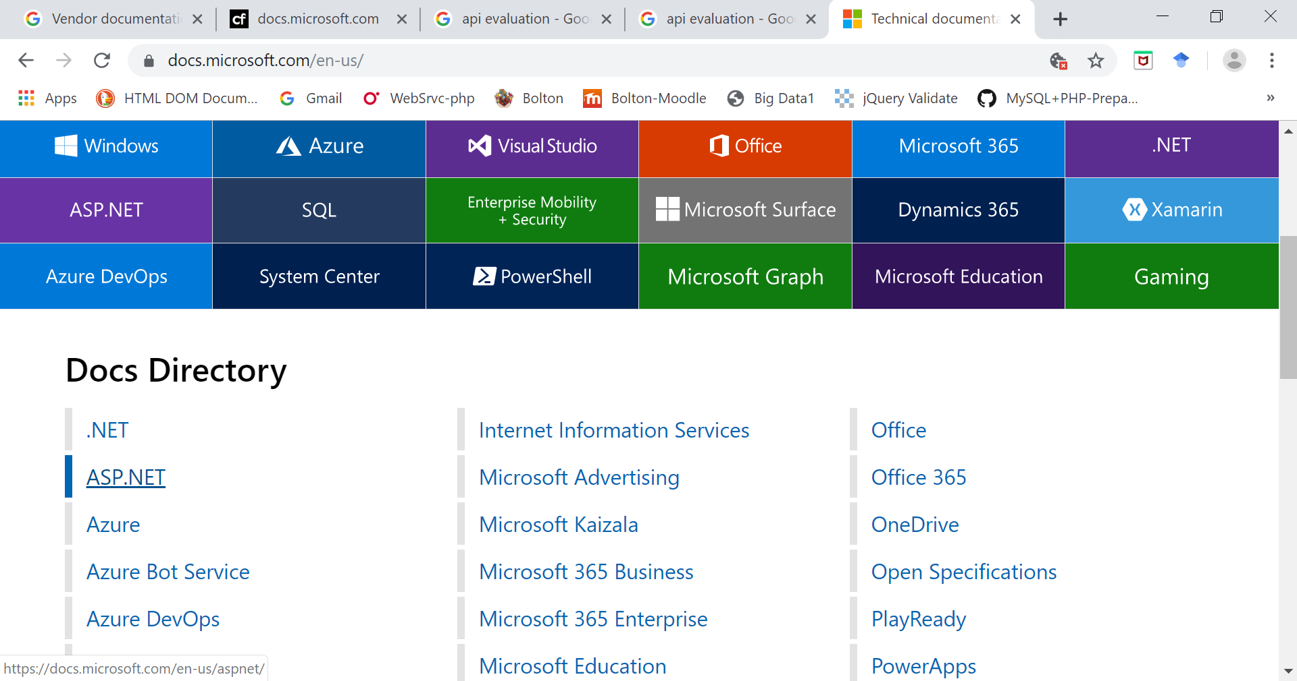
Application programming interface
An API specification can take many forms like:
International Standard (Rules)
such as HTTP
or
B. Vendor documentation such as the Microsoft Windows API,
Notes:
https://docs.microsoft.com/en-us/
https://www.ittutorialswithexample.com/2015/01/simple-windows-form-login-application-in-csharp.html

Slide 5
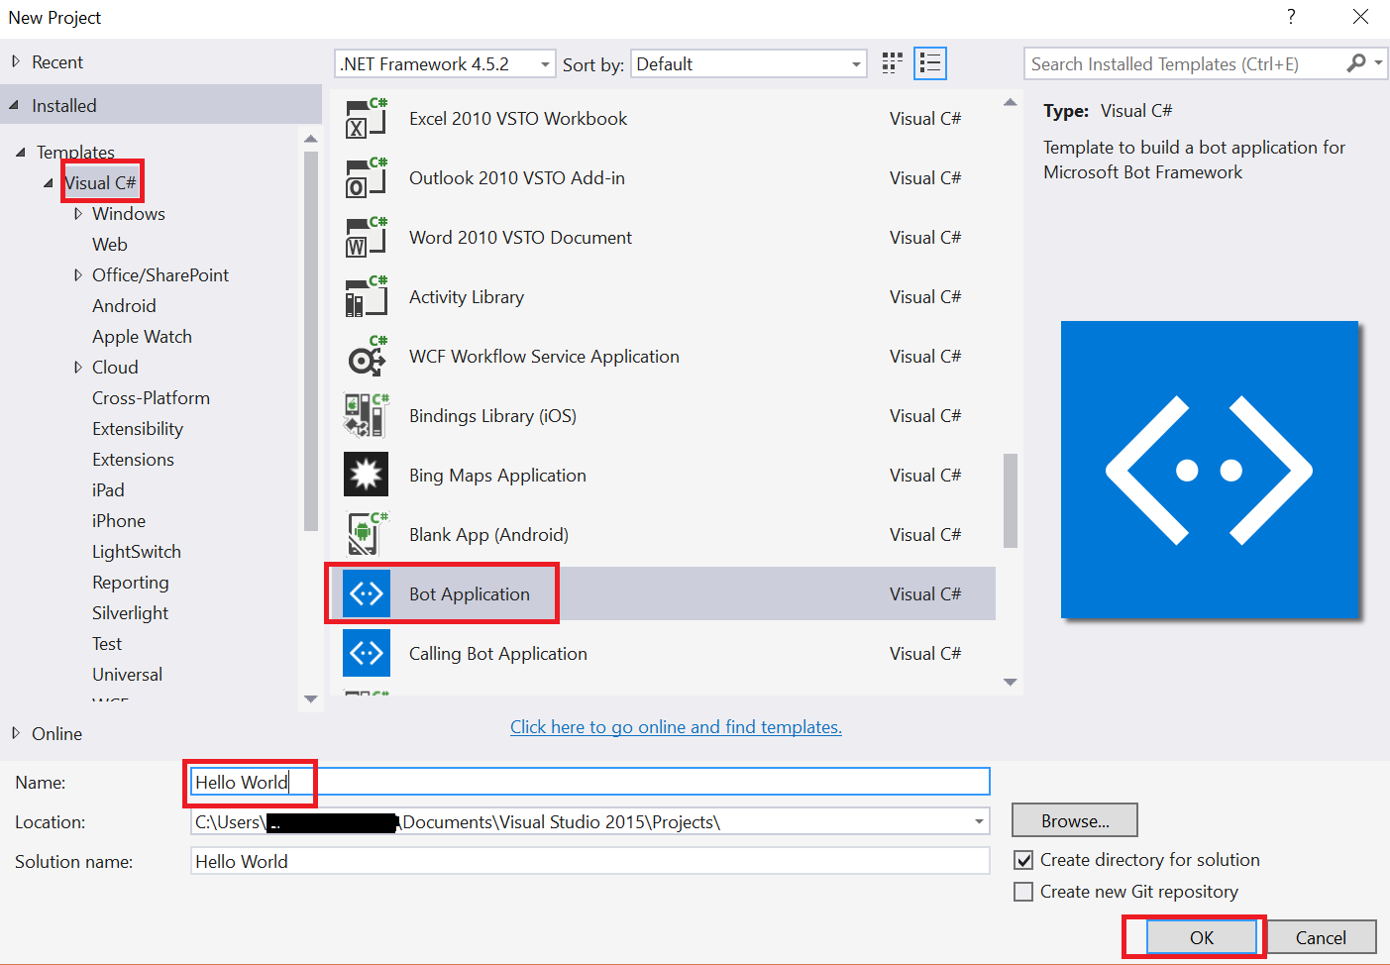
Application programming interface
An API specification can take many forms like:
International Standard such as HTTP or
Vendor documentation such as the Microsoft Windows API, or
C. Libraries of a
programming language,
e.g. Standard Template Library
in C++ or Java API or C# API.
Notes:
https://tutorials.botsfloor.com/creating-a-bot-using-c-and-microsoft-bot-framework-a344420f9d6f?gi=6a170d557743
https://docs.microsoft.com/en-us/
https://www.ittutorialswithexample.com/2015/01/simple-windows-form-login-application-in-csharp.html

Slide 6
Different Types of APIs
There are many different types of APIs for :
operating systems,
applications or
websites.

Slide 7
Different Types of APIs a. Operating systems api
Operating systems, like Windows and UNIX,
OS offer API’s, so that software programs can interact with the OS.
Examples:
Access to the file system,
printing documents,
displaying the content of a file on the console,
error notifications,
access to the user interface provided by the OS.
when you copy and paste text from one application to another, it is the API that allows that to work.

Slide 8
Different Types of APIs a. Operating systems api
Notes:
https://askubuntu.com/questions/106666/is-there-a-way-to-make-a-file-that-would-run-a-terminal-command-when-you-click-i

Slide 9
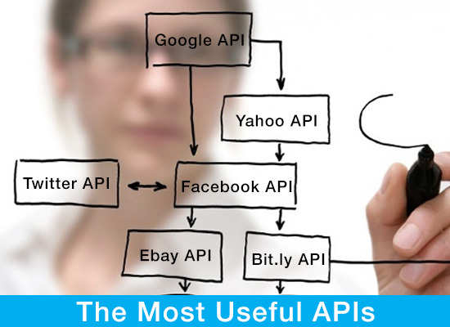
Different Types of APIs c. Web Api
Notes:
https://www.slideserve.com/kasie/cisco-nac-guest-server-guest-access-simplified

Slide 10
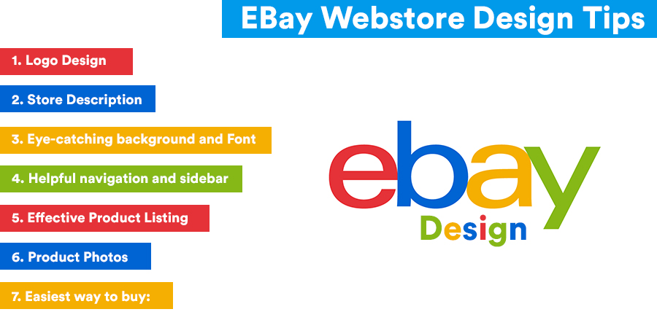
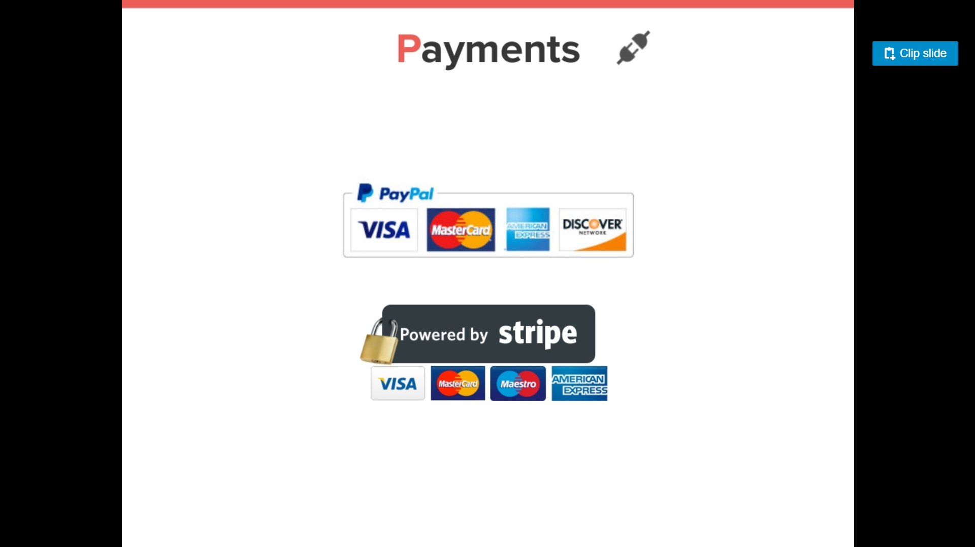
Different Types of APIs c. Web Api
Amazon or eBay APIs allow developers to use the existing retail infrastructure to create specialized web stores.
Third-party software developers use Web APIs to create software solutions for end-users.
(Use of Paypal to perform money transactions online)

Slide 11
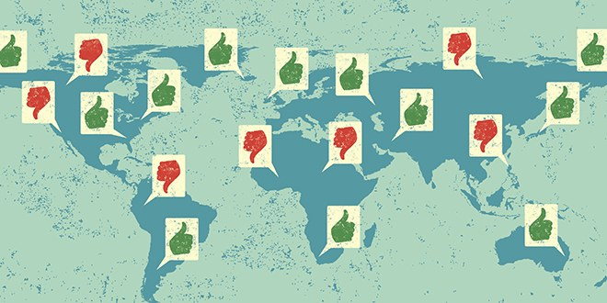
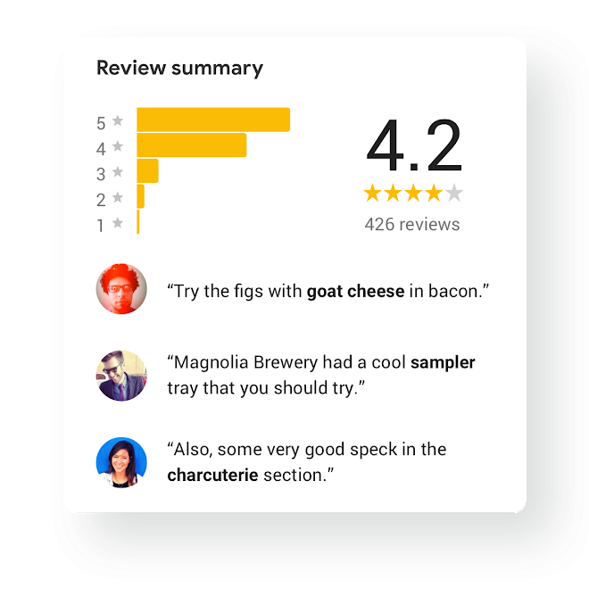
Google Maps APIs
(Beal, unknown) Google Maps APIs lets developers insert Google Maps on webpages.
Google Maps API is designed to work on mobile devices and desktop browsers.
Ex, a website that allows users to review local restaurants
is able to layer their reviews over maps taken from Google Maps,
because Google Maps has an API that facilitates this functionality.
Notes:
https://developers.google.com/my-business/
https://www.wired.com/2014/07/hacking-google-maps/
www.webopedia.com/TERM/A/API.html

Slide 12
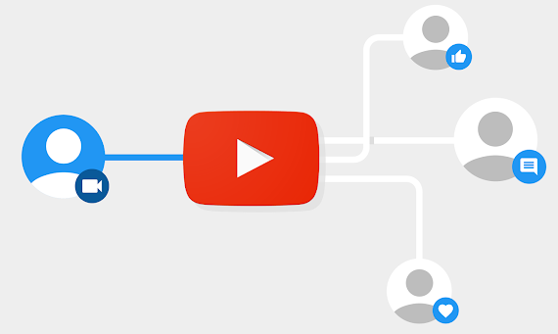

YouTube API
Google's APIs lets developers integrate YouTube videos and functionality into websites or applications.
YouTube APIs include:
YouTube Analytics API (Understand your users and how they interact with your channel and your videos.)
YouTube Data API (Let users search YouTube content, upload videos, create and manage playlists, and more.),
YouTube Live Streaming API, YouTube Player APIs and others.
Notes:
https://developers.google.com/youtube/
www.webopedia.com/TERM/A/API.html

Slide 13
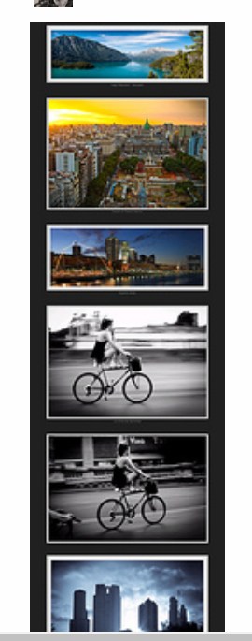
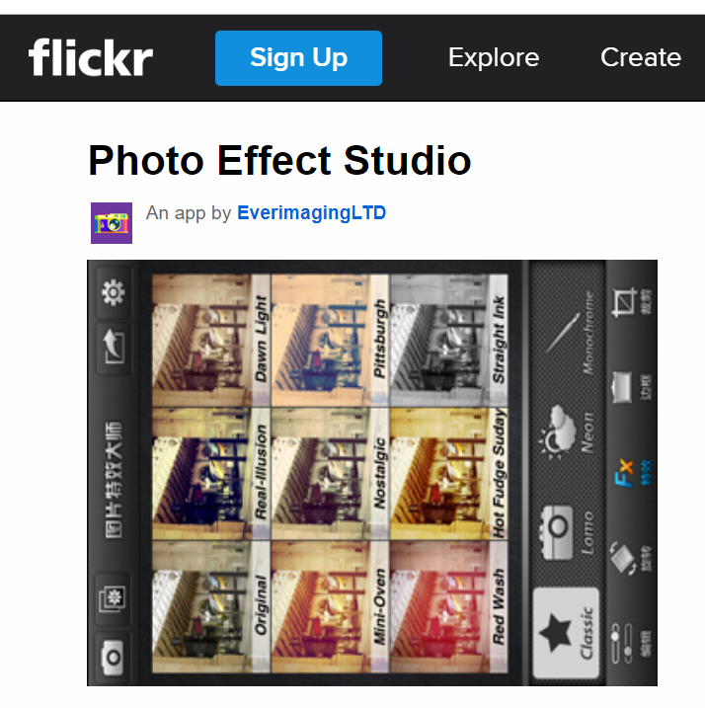
Flickr API
Flickr API is used by developers to access the Flick photo sharing community data.
The Flickr API consists of a set of methods.
Flickrock : free viewer application that works using the official Flickr sharing API. Provide photographers a suitable frame to showcase their portfolio.
Notes:
https://www.flickr.com/services/apps/72157608615542312/
www.webopedia.com/TERM/A/API.html

Slide 14
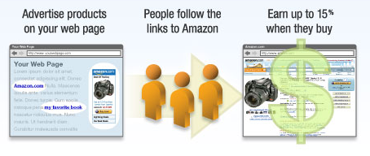
Amazon API
Amazon's Product Advertising API gives developers access to Amazon's product selection and discovery functionality, to advertise Amazon products to monetize a website.
Operations available in the Product Advertising API:
Search
Cart
CartAdd
CartCreate
CartGet
CartModify
Notes:
https://docs.aws.amazon.com/AWSECommerceService/latest/DG/CHAP_OperationListAlphabetical.html
https://apievangelist.com/2011/05/06/amazon-affiliate-program-is-integrated-with-product-api/
www.webopedia.com/TERM/A/API.html

Slide 15
API Evaluation
Security
Design
Notes:
https://www.youtube.com/watch?v=aAb7hSCtvGw

Slide 16
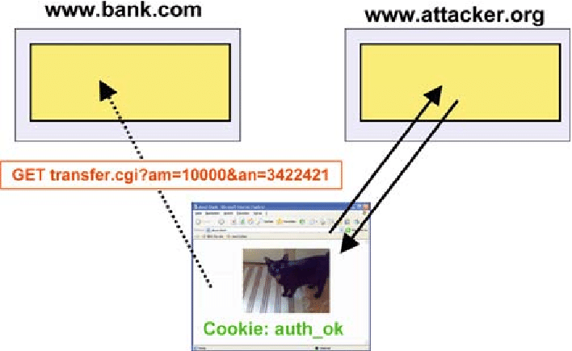
Security of API
Example Attack Scenarios
Scenario #1:
A mobile banking app that connects to API at the bank for account information and performing transactions.
The attacker reverse engineers the app and discovers that
the user account number along with the username and password
is passed as part of the authentication request to the server.
The attacker sends legitimate credentials, about another user’s account number, gaining full access to the other user’s account.
Notes:
https://www.owasp.org/index.php/Top_10_2017-A10-Underprotected_APIs

Slide 17
Security of API
Example Attack Scenarios
Scenario #2
Imagine a public API offered by an Internet startup for automatically sending text messages.
The API accepts messages that contain a “transactionid” field.
The API considers this “transactionid” value as a string and makes it into a SQL query.
API is susceptible to SQL injection.
Notes:
https://www.owasp.org/index.php/Top_10_2017-A10-Underprotected_APIs

Slide 18
How Do I Prevent 'Underprotected APIs'?
The key to protecting APIs is to ensure that you fully understand the threat model and what defenses you have:
Ensure that you have secured communications between the client and your APIs.
Ensure that you have a strong authentication scheme for your APIs, and that all credentials, keys have been secured.
Ensure that whatever data format your requests use, that the app is secure against attack.
Implement an access control scheme that protects APIs from being improperly executed
Protect against injection of all forms
Be sure your security analysis and testing covers all your APIs

Slide 19

API Evaluation 2. API Design
Follows Kernighan and Pike, The Practice of Programming and
Joshua Bloch’s Library-Centric Software Design ’05 Keynote Talk: ”How to Design a Good API and Why It Matters”
Notes:
https://www.youtube.com/watch?v=aAb7hSCtvGw

Slide 20
Characteristics of Good APIs
Easy to learn
Easy to use even without documentation
Hard to misuse
Easy to read and maintain code that uses it
Sufficiently powerful to satisfy requirements
Easy to extend
Appropriate to audience

Slide 21
Broad Aspects to Consider in Design
1. Interface
The classes, methods, parameters, names
2. Resource Management
How is memory, other resources dealt with
3. Error Handling
What errors are caught and what is done
4. Information Hiding
How much detail is exposed
Impacts all three of the above

Slide 22
1. Interface Principles
Simple/Comprehensibility
General
Regular
Predictable
Robust
Adaptable

Slide 23
1. Interface Principles A. Comprehensibility
“Those who have to use an API must be able to understand it."
Users have to understand!
Do one thing and do it well
Functionality should be easy to explain
Don’t provide 3 ways to do the same thing

Slide 24
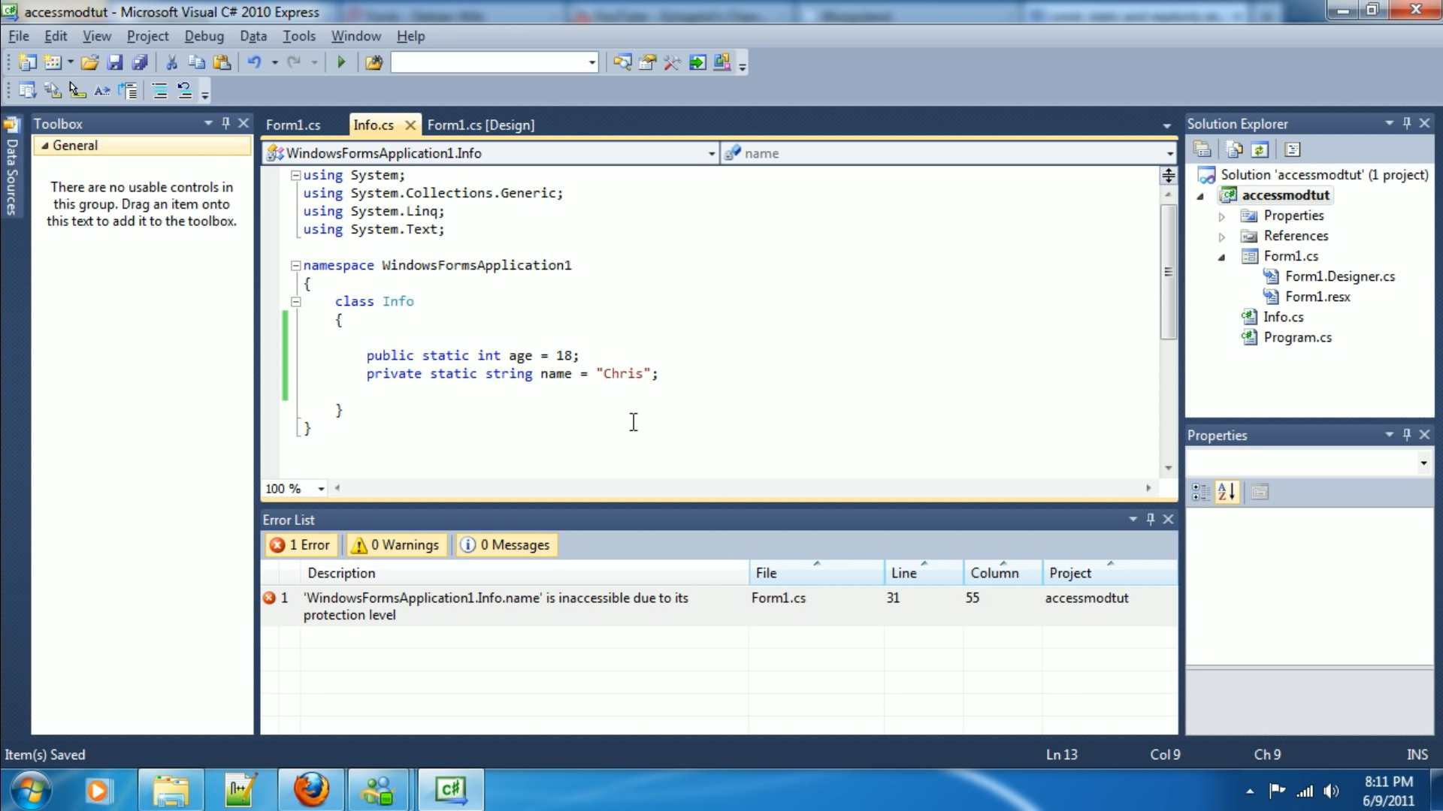
1. Interface Principles B. General
Hide Information!
Don’t let implementation detail(Code) leak into API
Minimize accessibility (e.g. private members)
Notes:
https://www.youtube.com/watch?v=NZ2MMH-1UDo

Slide 25
1. Interface Principles C. Regular
Do the same thing the same way everywhere
Names matter
Self explanatory
Consistent across API
Same naming style used

Slide 26
1. Interface Principles D. Predictable
Don’t violate the principle of Least Astonishment
User should not be surprised by behavior
Try to minimize use of other interfaces
Make as self-contained/independent as possible
Document!
Every class, method, interface, constructor, parameter, exception
this should be very clearly documented

Slide 27
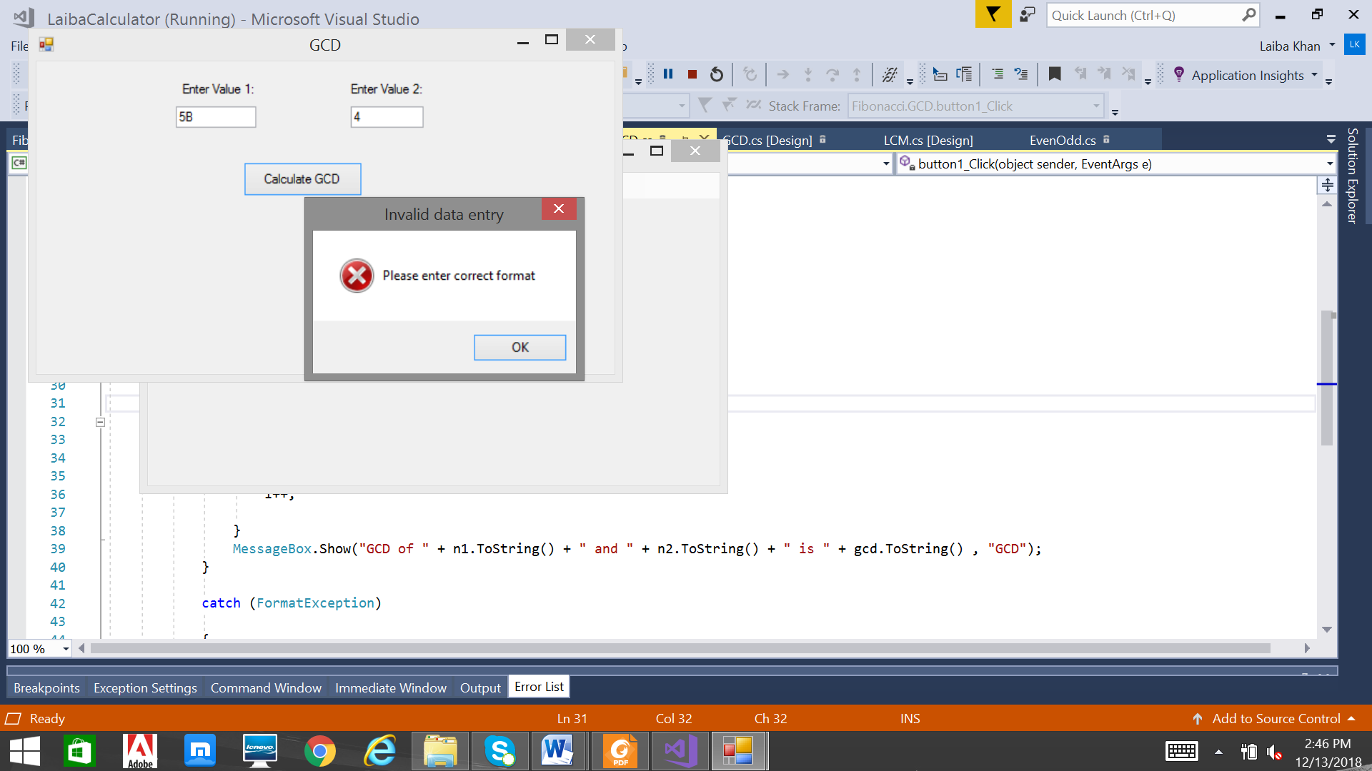
1. Interface Principles E. Robust
Able to deal with unexpected input
Error Handling (see later)

Slide 28

1. Interface Principles F. Adaptable
API can be extended
Heavily used APIs likely will be extended
Information Hiding
Implementation details should not affect API

Slide 29
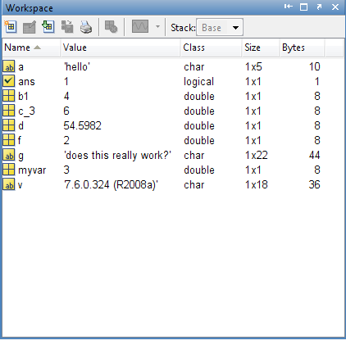
2. Resource Management
Determine which side is responsible for
Initialization
Sharing and copying
Cleaning up
(Free resources where they were allocated and no longer required)
Resources:
Memory
Files
Global variables

Slide 30
3. Error Handling
Catch errors, don’t ignore them
“Print message and fail” is not always good
Need to allow programs to recover or save data
Return values
Return as much useful information as possible
Return a parameter to indicate errors

Slide 31
Advantages of using API for developers and software providers:
Accelerating application development process through eliminating the need to build individual integration methods for every desired application
Increasing the app’s functionality by providing the access to the data from other solutions
Expanding the potential client circle by attracting the users of integrated tools.
APIs allow to include lots of additional functions into your app by simply adding a few lines of code.
Notes:
https://www.data2crm.com/api/blog/general/need-api-beginners-guide-api-technology/

Slide 32
References:
Author or Organisation. (Year) Title. [Online] Available from: URL. [Accessed Date].
Ajith Mungale. (2001) C# and API. [Online] Available from: https://www.c-sharpcorner.com/article/C-Sharp-and-api/. [Accessed 25 September 2018].
Gustavo De Vita. (2016) API for Beginners. [Online] Available from: https://www.slideshare.net/gdevita/api-for-beginners-67138881?next_slideshow=1 .[Accessed 20 September 2018].
Sarah Maddox (2014) API types. [Online] Available from: https://ffeathers.wordpress.com/2014/02/16/api-types/ .[Accessed 22 September 2018].
Beal V. (unknown) API - application program interface. [Online] Available from: https://www.webopedia.com/TERM/A/API.html .[Accessed 21 September 2018].
Ziff Davis, Definition of: API. [Online] Available from: https://www.pcmag.com/encyclopedia/term/37856/api.[Accessed 22 September 2018].

Slide 33
References
https://www.owasp.org/index.php/Top_10_2017-A10-Underprotected_APIs
https://www.youtube.com/watch?v=aAb7hSCtvGw
“How to Design a Good API and Why it Matters Joshua Bloch”-www.cs.bc.edu/~muller/teaching/cs102/s06/lib/pdf/api-design
Notes:
ftp://ftp.inf.puc-rio.br/pub/docs/FomularioSolicitacoes/LuisMarques-12-13-51514.pdf

